Slide 1
Sub Agents Assignment
January 1, 2026

Slide 2
Agent Description
Tutor-Agent
Describe what this agent should do and when it should be used (be comprehensive for best results)
Create an agent named tutor-agent that uses specialized and focused expertise of study-notes to guide my learning through multi-step pedagogical approach.
This agent should be used when user explicitly asks to learn, study, understand, or master a new concept, framework, or topic, or requests structured explanations, or step-by-step learning guidance.
Activation Prompt: teach me how to stay healthy in winter.

Slide 3
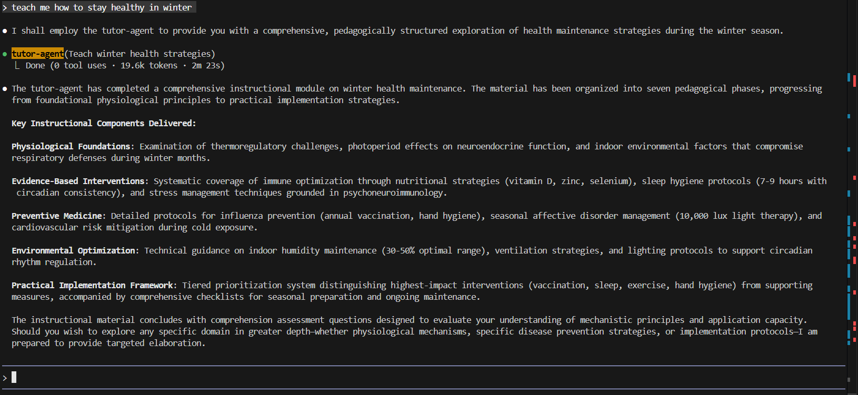
Agent Activation

Slide 4
Agent Description
Flashcard-Agent
Create an agent named flashcard-agent that tactically uses specialized and focused expertise of study-notes, tutor-agent and its own ability to actively recall (strengthen long term memory and reveal knowledge gaps), spaced repetition (prevent forgetting, optimize study time, increased retention with low effort), concept reinforcement, perform self-assessment and feedback, help in interview and exam preparation, skill automation (debugging heuristics, design patterns, medical protocols, legal tests, command syntax) and to guide user in learning new language (through increased vocabulary, grammar patterns, sentence structures and pronunciation cues).
Use this agent when the user has learned a topic or concept to reinforce memory, during review, exam prep, spaced repetition or for support in learning a new language.
Activation Prompt: Using the Tutor Agent Output above, generate a flashcard that tests understanding, not memorization. Focus on conceptual distinction and application scenarios

Slide 5
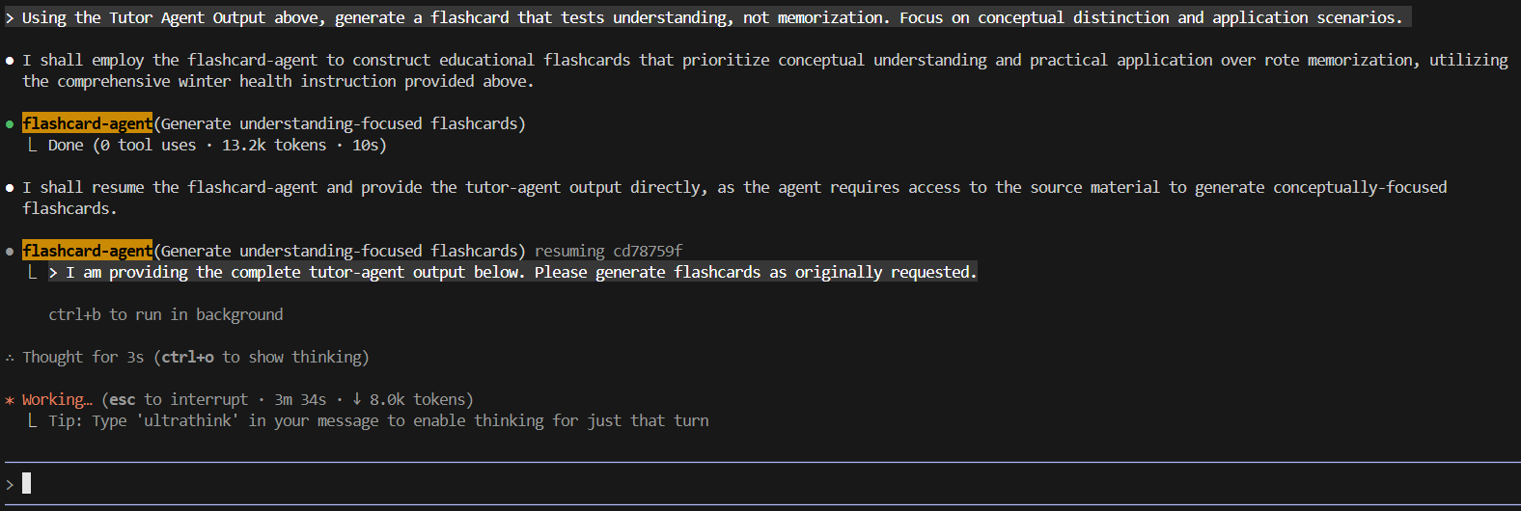
Work in Progress

Slide 6
Agent Description
Quiz-Master
Create an agent named quiz-master that intelligently wraps specialized and focused expertise of study-notes, tutor-agent and contains expertise to generate meaningful questions from source content, to generate assessment items (questions, prompts, distractors) from learning material, to design evaluative questions to measure understanding, to promote active recall from learned material, to reinforce learning during study, to encourage explanation and reasoning, to verify comprehension of key concepts and to guide user learning through multi-step pedagogical approach.
Use this agent when the user wants to reinforce newly learned concepts, evaluate their understanding of a topic, or practice active recall during or after study.
Activation Prompt: Using the Tutor Agent Output above, generate a 2 question quiz

Slide 7
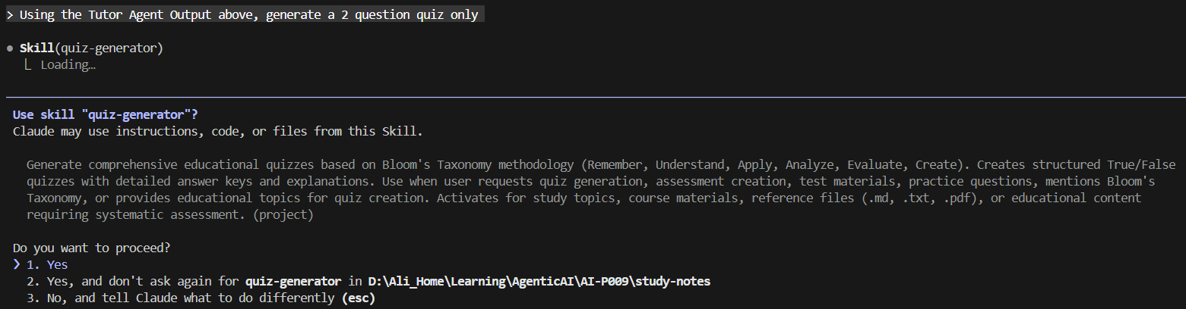
Work in Progress

Slide 8
Agent Description
study-coach
Create an agent named “study-coach” that coordinates the other three agents (tutor-agent, flashcard-agent, quiz-master) to ensure the tutor-agent manages to teach the user, flashcard-agent manages to reinforce memory (during review, exam prep or spaced repetition) and quiz-master intelligently reinforces learning (newly learned concepts, evaluate understanding, practice active recall).
Use this agent when the user has completed the learning from tutor-agent, memory reinforcement from flashcard-agent and reinforced learning from quiz-master.
Activation Prompt: Use the study-coach agent to manage the agent coordination of very briefly teaching a 30 years old health enthusiast how to stay healthy in winter. Then firstly use the output to create nothing else but a short flashcard. Then, also use the same output to generate a two question quiz only.

Slide 9
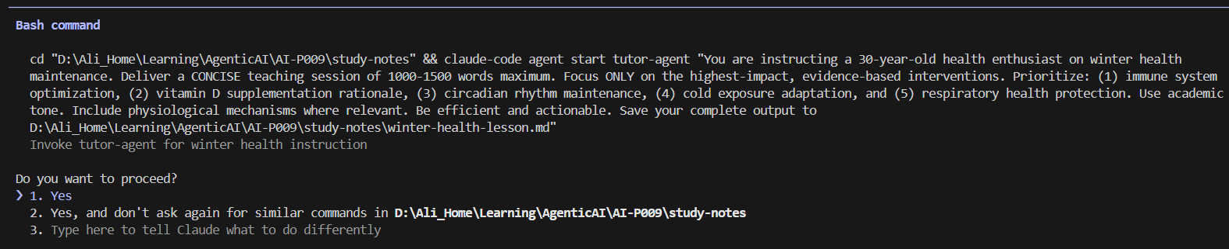
Work in Progress: winter-health-lesson.md

Slide 10
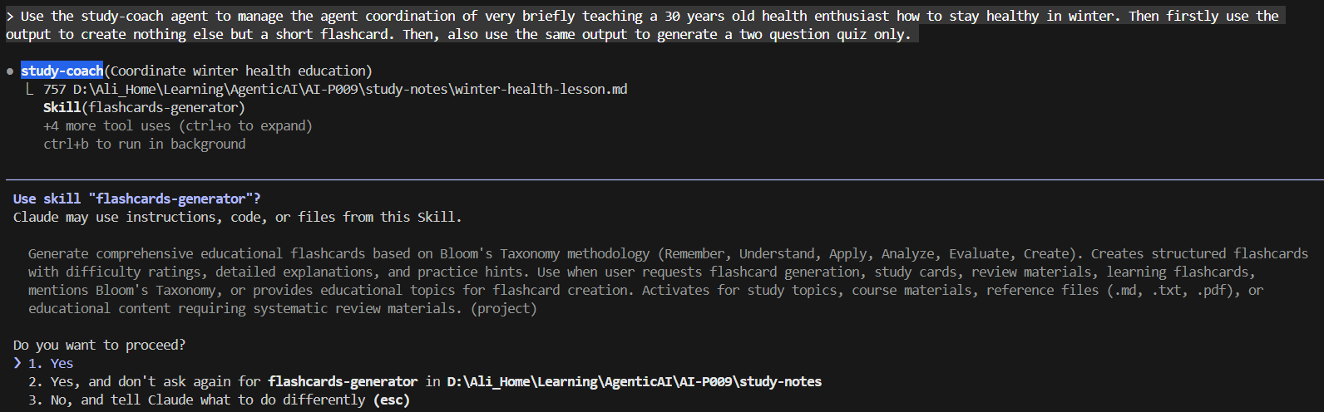
Work in Progress

